Slide 1

How to Prepare for a
Portfolio Evaluation
(…without losing your mind!)
© 2010, Carleen Galiardo

Slide 2
Every homeschooler is required to have a portfolio…
So why not use it to meet the requirement for your annual homeschool evaluation?
This presentation is intended for Florida based homeschoolers who have chosen to use their child’s portfolio to meet the requirement for their yearly, state mandated evaluation.
The guidelines presented here are based upon requirements mandated by state law and brought to you by…
EvaluationStation.Com

Slide 3
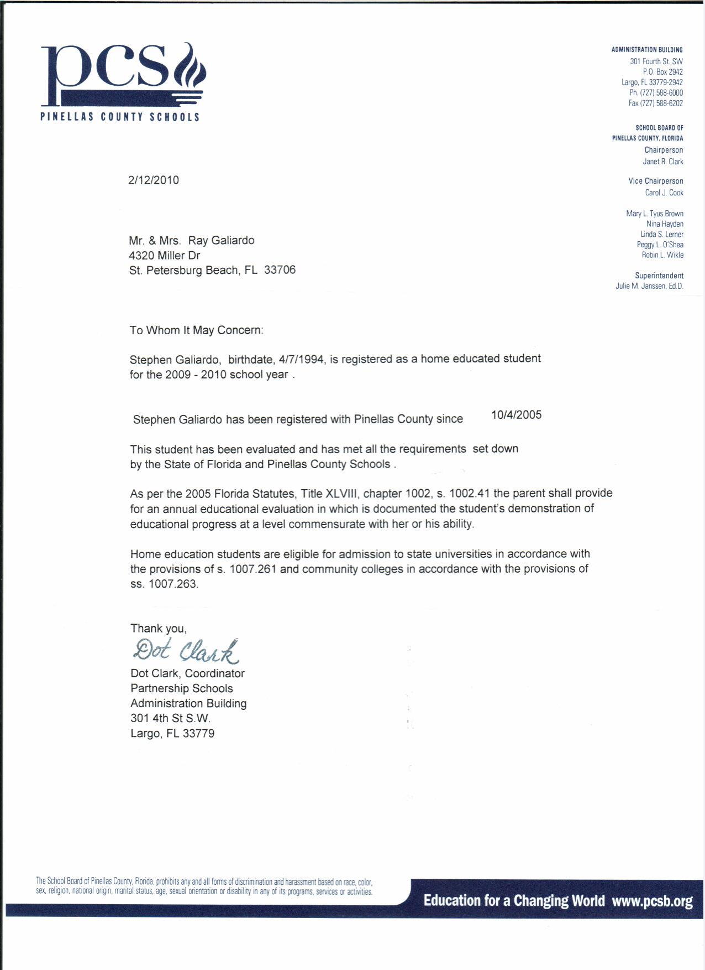
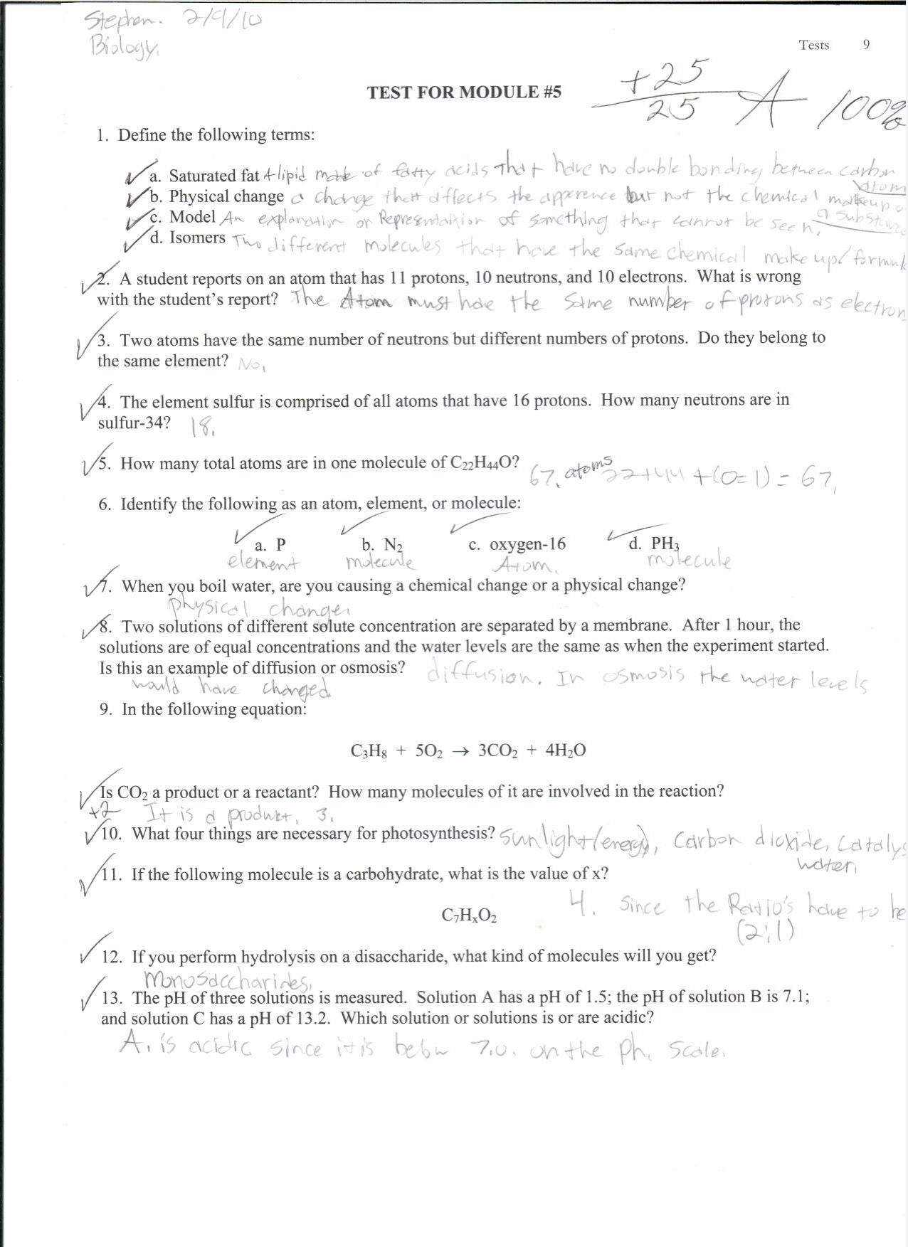
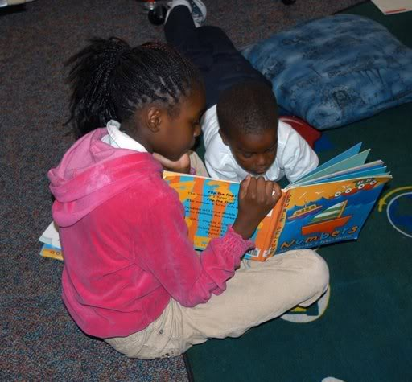
A portfolio is…
an organized collection of
          records & documents,
          lists & work samples,
          photos, videos, & awards
that tell the story
of your child’s year of homeschooling.

Slide 4

A portfolio is not…
EVERYTHING your child has accomplished all year!

Slide 5
A portfolio can be… plain or fancy.
The
Portfolio
Of
Robert Galiardo
2010 - 2011
You can submit a portfolio in-person, online or by mail. An online evaluation is more in-depth (and cheaper!). You don’t have to wait while your evaluator goes through your portfolio! After your portfolio is reviewed, we’ll just meet online using Skype, FaceTime, or Facebook Messenger-video option, and you will receive detailed feedback, guidance, and encouragement. If all goes well, your Certificate of Review will be emailed directly to you and your County Liaison.

Slide 6

But a portfolio should have these essential elements.
Letter of Registration
Curriculum List*
Pleasure Reading List
Daily Activities Log*
Work Samples*
Any Special Projects/Awards
“Let’s explore these elements.
Next slide please!”
*Underlined elements are those required by state law.
If you use FLVS, read the special section for you at the bottom of the Services page.

Slide 7
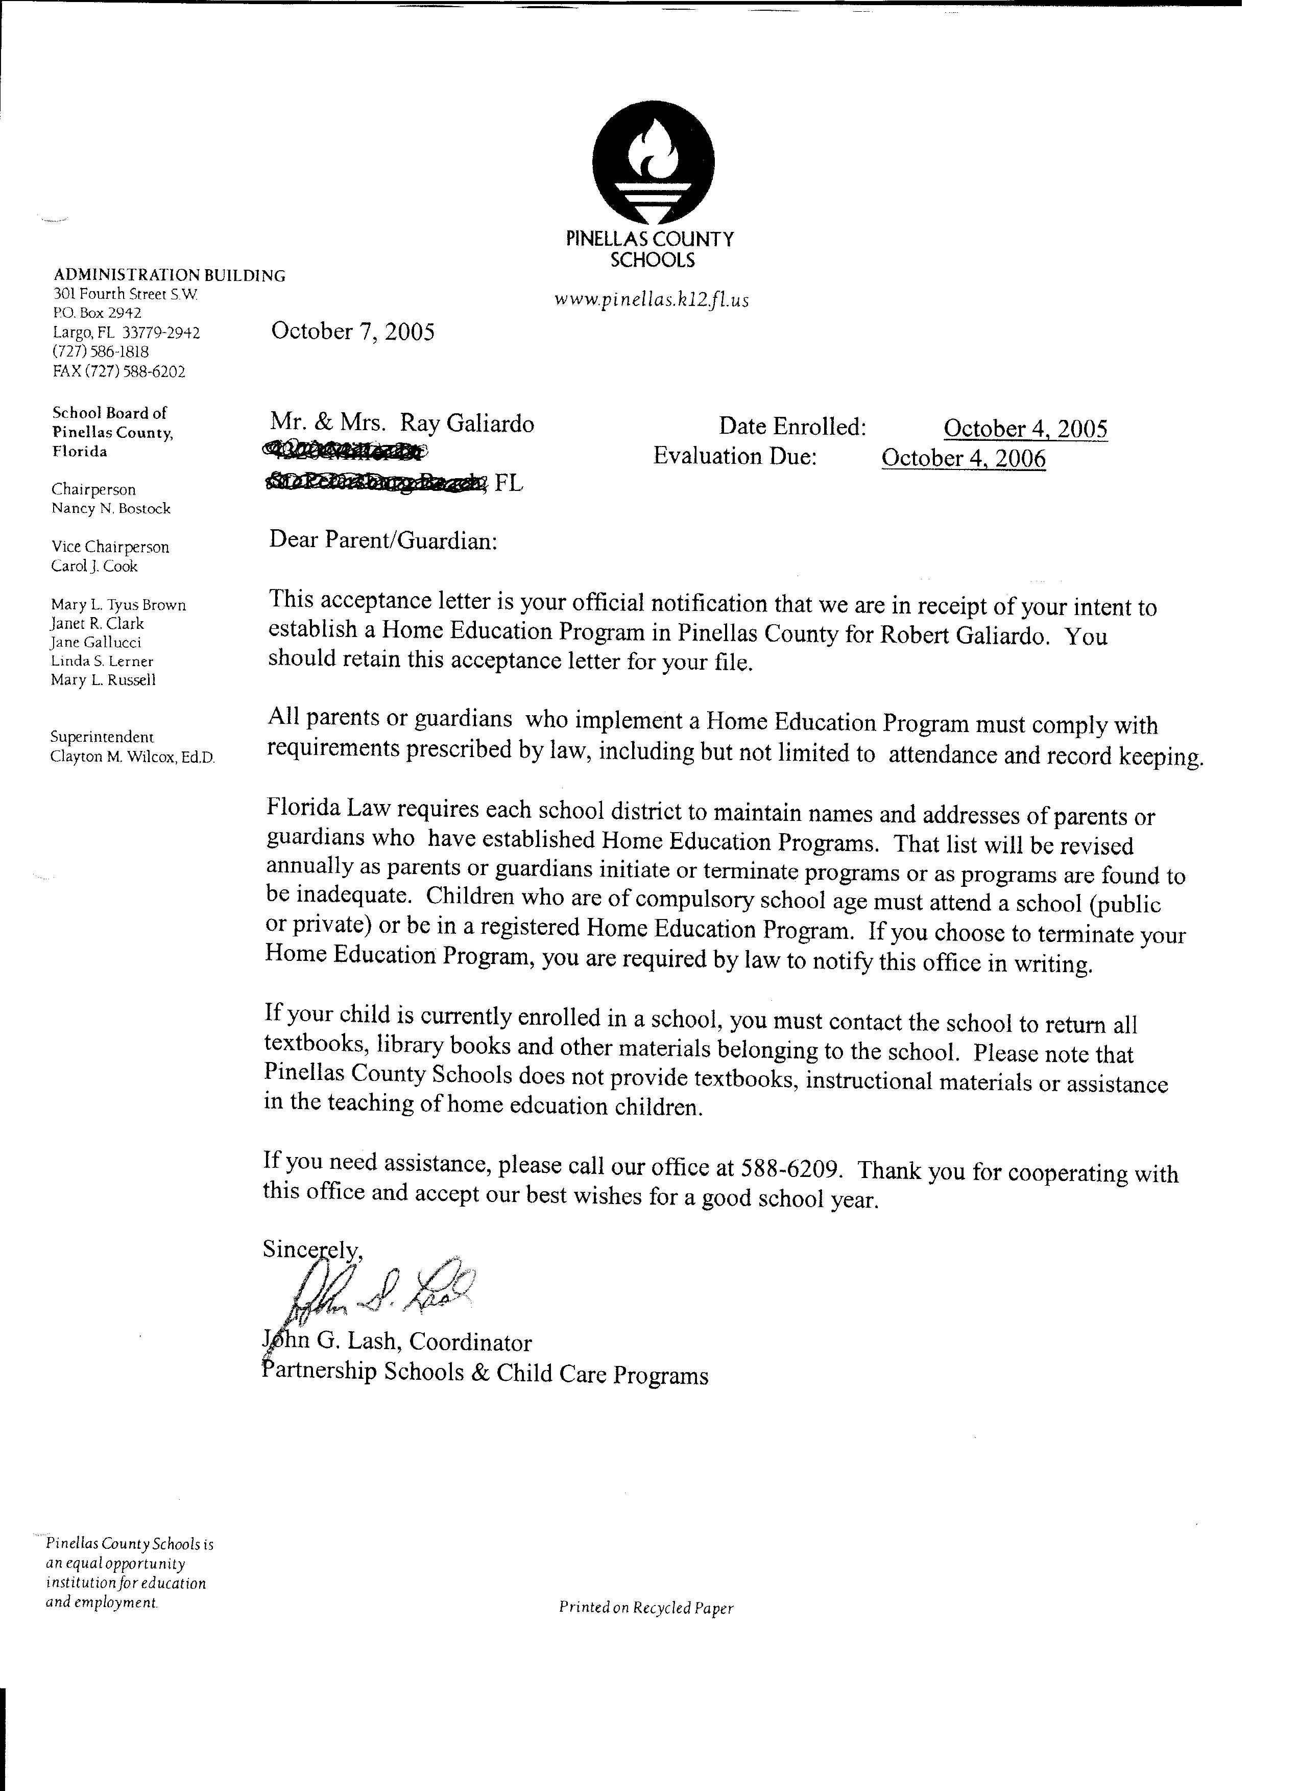
Letter of Registration
This an example of an official acceptance letter from the county acknowledging a parent’s intent to establish a home education program for their child.
The enrollment date in the upper right corner serves as the date your child’s yearly evaluation is due.
Be sure to schedule your evaluation early enough to ensure that you can get your “Certificate of Review” submitted to the county on time. Being late can give the county permission to either bring you before the board and/or close your homeschool program.
If you are going to be late, call your county liaison and ask for a two week extension. Then get busy!

Slide 8
Curriculum List
The Curriculum List is an element required by law. It should show each subject your child is taking and the materials used to teach that subject-including books, videos, DVDs and any online resources. Title and author will suffice. Listing them in detail here relieves you from listing them in such detail on the daily log. (Books read for pleasure are included on the “Pleasure Reading List.”) Also- no need to list every book in the reading program you used.

Slide 9



Pleasure Reading List
Should I include a list of PLEASURE books we read this year?
Yes, and
Yes!
Do library receipts count?
The Pleasure Reading List is not an element required by law, but it speaks volumes about the interests of the student, and their interest in reading in general. This helps me relate to them and address any needs in this area during our interview. You may be able to set up an account with your library to keep your entire list on file and download it before your evaluation! If not, just list title and author and submit with portfolio. Some kids like to rate their books!

Slide 10
Daily Log
An important element required by law. You can download my template for this which is located under “Educational Tools” on the “Links and Resources” page on my site. It will make this a lot easier.
Write down what you are planning & accomplishing each day in simple but detailed terms.
Doing this at the beginning of each week will REALLY improve your homeschooling!
I need to see three pages of this, or something like it, from the beginning, middle, & end of the year.
 | Mon. | Tues. | Wed. | Thurs. | Fri.
(Dates ➔) | 8/15 | 8/16 | 8/17 | 8/18 | 8/19
Bible | John Ch. 1-2 | John Ch 3-4 | John Ch. 5-6 | John Ch. 7-8 | John Ch. 9-10
History | Read, “Diary of Sally Hester, 1849-1850” | Pick an activity to do from “Sally” book. | Make supply list for trail trip and map trail. | Research the “Donner Party” & give oral report. | Play “Oregon Trail” on Computer.
Science | Read pp. 1-15, Complete OYO questions | Write-up Lab 1.1, 1 & 2. Watch video for Class session # 4. | Complete Lab write-up 1.1, 3 & 4 | Read pp.16-22, Complete OYO questions | Write-up Lab 1.2, 1 & 2. Watch video for class session # 5.
Reading& Lang. Arts | IEW-Make keyword outline from ”Advances in Medicine” article. Orally recreate. | IEW-Write story outline for,”Advances in Medicine” using keyword outline. | IEW-Rewrite “Advances” using outline. Add “Dress-ups” and “sentence openers.” | IEW- Use “Checklist” and type up composition. | IEW- Present composition orally!
Math | Work online for 1 hour at KhanAcademy.Org | Work online for 1 hour at KhanAcademy.Org | Work online for 1 hour at KhanAcademy.Org | Work online for 1 hour at KhanAcademy.Org | Work online for 1 hour at KhanAcademy.Org

Slide 11
Work Samples
We LOVE work samples!
Perhaps the most important part of a portfolio, and required by law.
Samples of daily work should be chosen from the beginning, middle and end of the year. Keep in mind I am looking for progress- not perfection. If your file is too large- feel free to leave out the middle of the year work samples.
Mark your calendar to remind you to select one sample from each subject area three times a year! If you are planning an online eval- now is the time to scan these samples into your computer rather than doing it all at once at the end of the year. (ALERT- Words of Wisdom!)
Work samples need to have the student’s name and date on them and they need to be GRADED. Only submit samples accomplished during the year we are evaluating.
Photos and recordings / videos of projects and performances count.
Remember- this is not EVERYTHING your child has done all year!

Slide 12
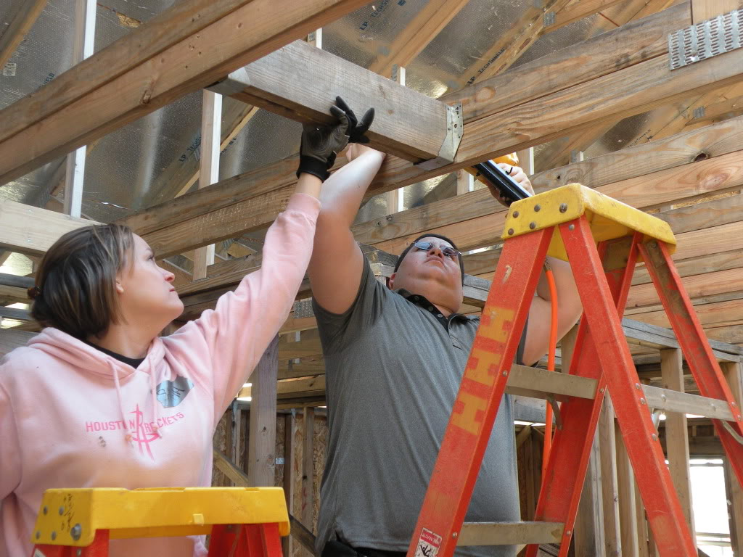

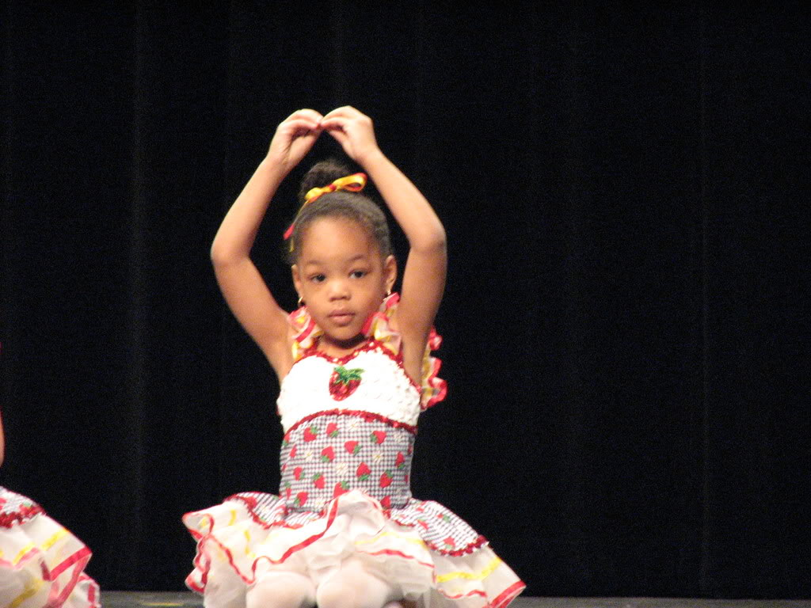
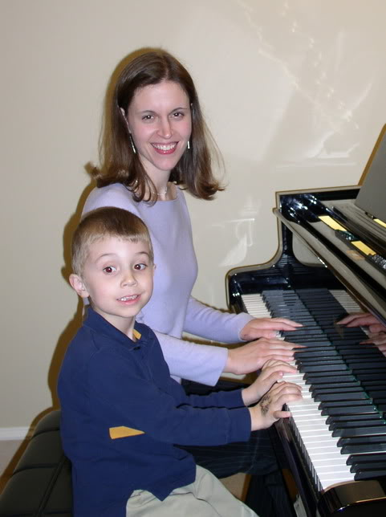
Extra-Curricular
THIS is where you get to show off!
This section is not required by law, but it is the difference between a basic portfolio and a portfolio that is a real “Keepsake”!
Include photos, pamphlets, scorecards, tickets, etc., of
Fieldtrips
  Mission trips
  Volunteer work
  Awards
  Clubs / Hobbies
  Recitals or Performances
  International travel / Exchange student experiences

Slide 13
How do I submit my portfolio?
If doing an online evaluation, use your copy machine to scan the portfolio elements into one of these online delivery systems. They are easy and free. There are a couple of additional options on the Services page, but these are the best…
☆ Put your portfolio into a simple PDF format. This is my favorite method, and I think, the easiest for you. See the tutorial in the center of my Services page concerning how to do this. It’s as easy as pie! Email it to me when you’re done.
☆ Make a Power-Point! As you can see as you scroll through this power-point, I don’t have to open multiple files (which slows down the entire review process.) I have a helpful tutorial that will walk you through how to do this in the center of my Services page. Email your power-point to me when you are done!
☆ You can also do it the old fashioned way and just MAIL it! Make copies of everything so I don’t have to mail it back to you. I will properly dispose of it when I’m done with the review. You keep the originals for a minimum of two years (required by state law.)
Whichever method you choose- be sure to group the work samples together by subject when you scan the items in so I don’t have to search through everything to find all the math, for example. And remember- not more than three samples from each subject area. Forget about just slapping it all in emails and sending it to me. This clogs up my email and can actually disable it, which will make a lot of people very angry. It’s a “no no.”

Slide 14

What’s next?
Use that handy “Checklist” on our Services page and then…
Meet with your Evaluator either
in-person or online
for some valuable feedback.
Enjoy another wonderful year of homeschooling!*
Submit to your evaluator the items seen in this presentation.
Pay for your evaluation using the PayPal option on the Services page of my site.
Fill out the “Contact” AND “Student Info Forms” found on
our Contact page. Hit “Submit” on each form.
*Upon completion of a successful review, I’ll email the Certificate of Review directly to you and to your county liaison. I will also send you some extra things to give you more feedback and help you all celebrate your successful year of homeschooling!

Slide 15
This presentation has been brought to you by EvaluationStation.Com
Visit our website to:
Download our handy “Checklist.”
Find out about some great resources.
Read client testimonies.
Receive support and encouragement on our “Laugh” page.
And browse our online store and visit, “The Christian Galiardo Memorial Library”!
God bless you on your homeschooling journey!
Certified Teacher and Homeschool Mom: Carleen Galiardo, B.A., Ed.
727 692-6596 Carleensforgiven@gmail.com
facebook: Evaluation Station! Blog: EvaluationStation.Blogspot.Com Twitter: @ThatEvalGal
© 2010, Carleen Galiardo

Slide 16
Bibliographical Info
Q. What is a portfolio? A.Section 1002.41, F.S. defines a portfolio as "A log of educational activities which is made contemporaneously with the instruction and which designates by title any reading materials used and samples of any writings, worksheets, workbooks, or reactive materials used or developed by the student." (As you teach, you should date and record the activities that occur and materials that are used.) The law further requires the parent or guardian to preserve the portfolio for two years and to make the portfolio available for inspection upon 15 days' written notice by the superintendent, or the superintendent's designee. Nothing in the Legislation requires the superintendent to inspect all portfolios.
This presentation was last updated October 7, 2017 and is a proprietary product of
EvaluationStation.Com

